Slide 1
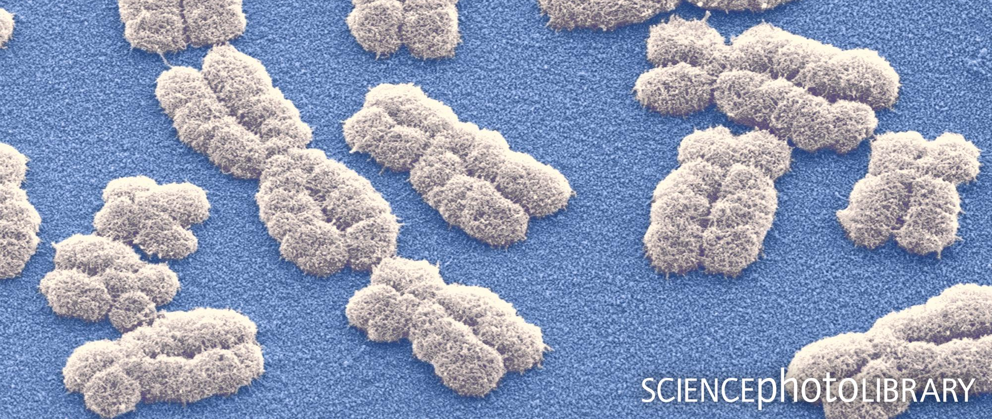
Evolutionary consequences of polyploidy
©Science Photo Library
Student:
Rampin Marco
Supervisor:
Mag. Dr. Karl Hülber

Slide 2
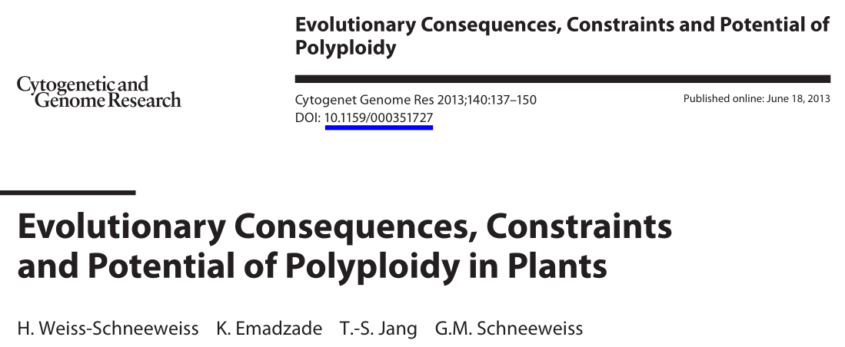
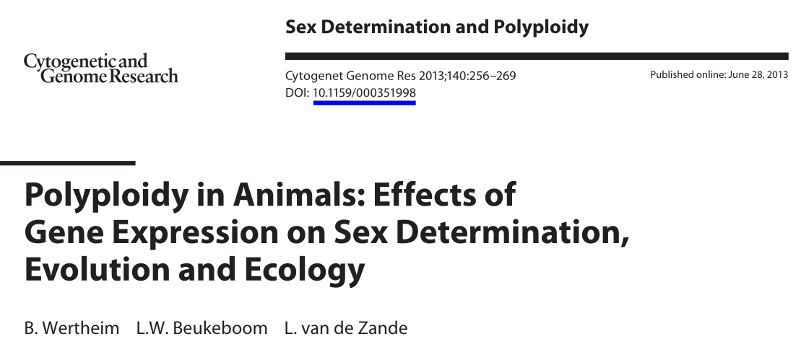
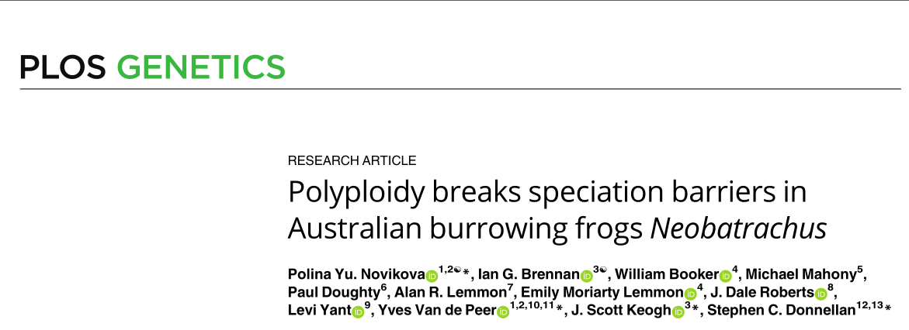
Literature

Slide 3
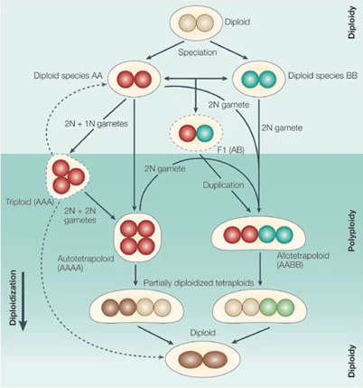
Introduction
Polyploidy: biological condition where cells of an organism possess more than one pair of homologous chromosomes.
Two main types:
Autopolyploidy: multiple nearly identical chromosome sets derived from a single taxon.
Allopolyploidy: chromosomes derived from two or more diverged taxa.
© Comai L.

Slide 4
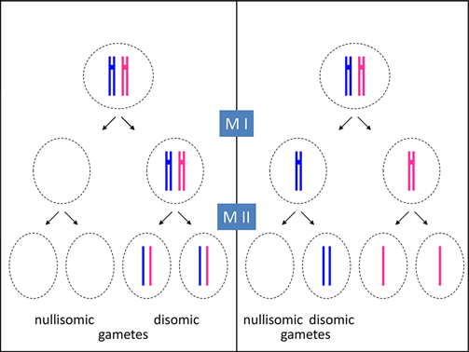
Causes and genetic consequences
Consequence of abnormal cell division, usually during meiosis
Benefits:
Increased genetic variation
Masks detrimental mutations
Stabilizes hybridization
Drawbacks:
Reduced fertility
Genomic instability
© Jackson M.

Slide 5
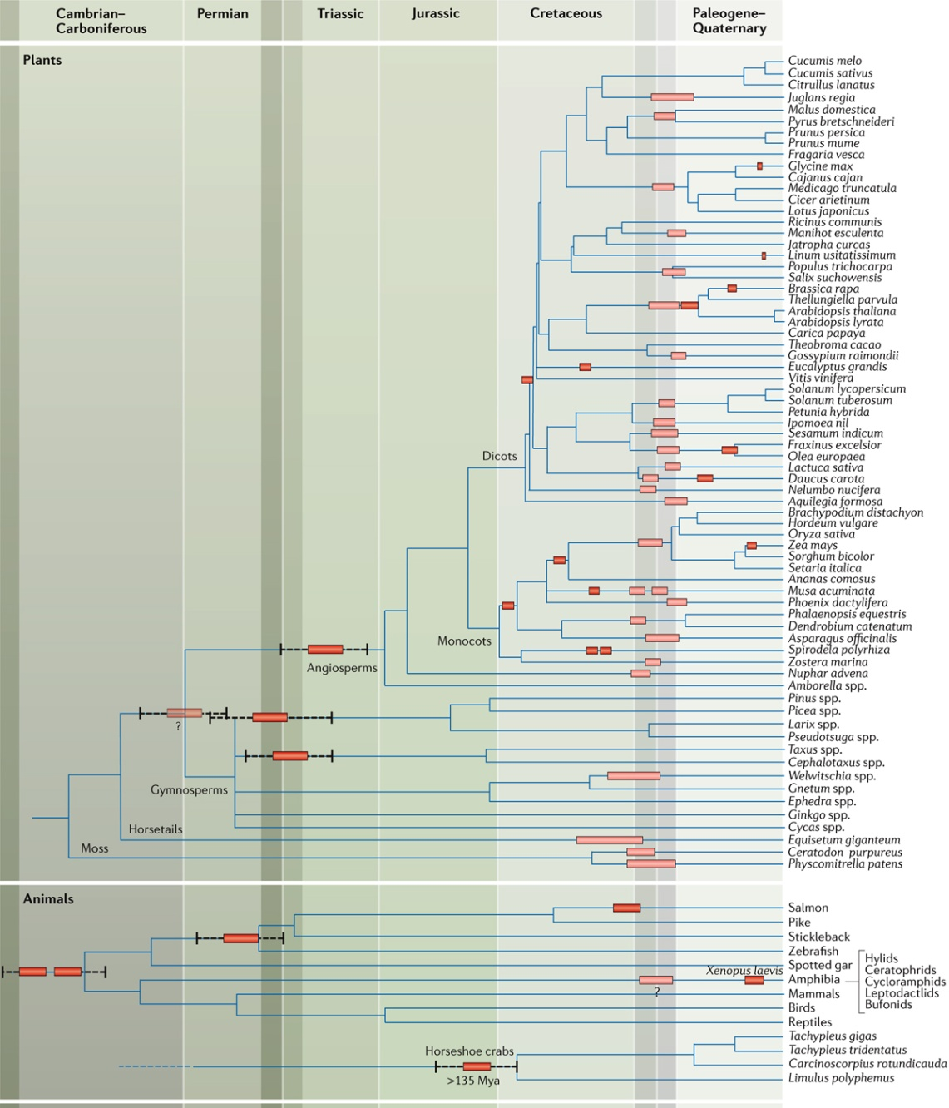
Paleopolyploid events
© Van de Peer Y.
Past WGD events in Angiosperms and Vertebrates
~30% of human genome associated with the ancient vertebrate WGD event
Unevenly distributed across lineages
Many WGD events occurring during environmental instability conditions (K-Pg mass extinction)

Slide 6
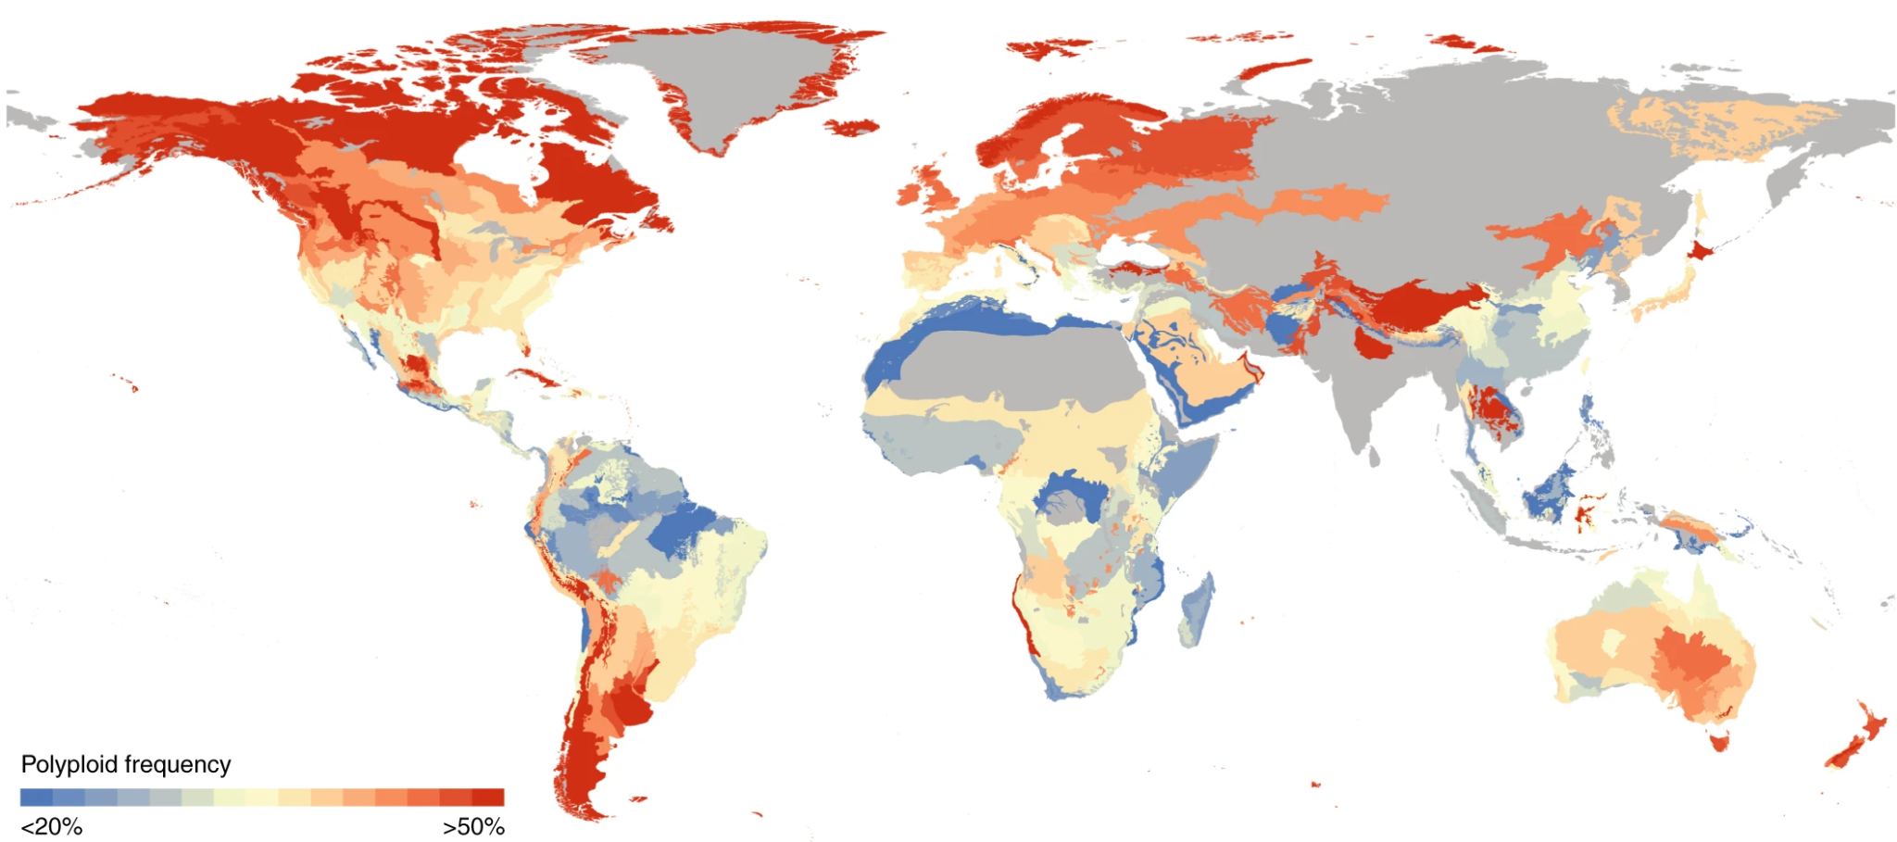
The incidence of polyploidy in plants
Considered a major force in plant evolution
Incidence influenced by:
Geographical distribution
Unreduced gamete formation rates
Growth form
Genome size
Species richness and polyploids frequency are positively related
© Rice A.

Slide 7
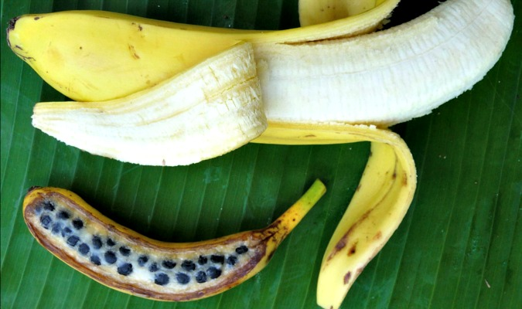
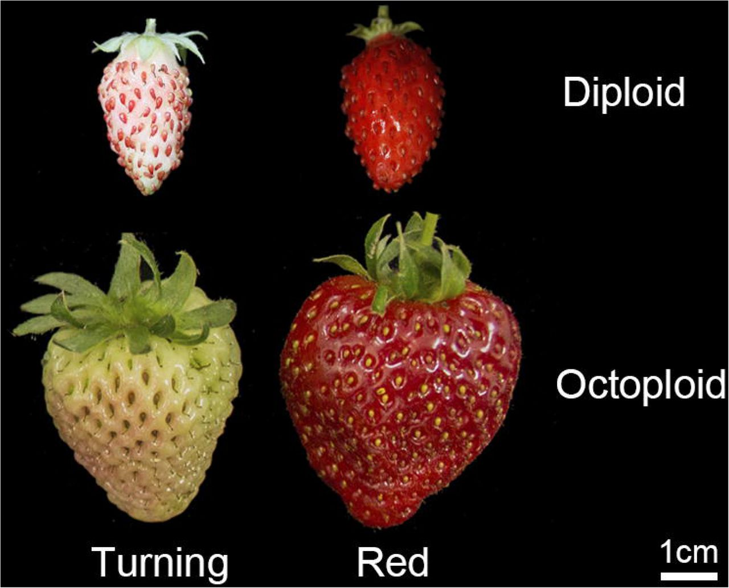
Plants: physiological changes
Usually associated with mutational robustness and increased adaptability
Common physiological effects:
Increased cell size
Accelerated growth
Changes in secondary metabolism
Larger habits
Increased size and number of flowers and fruits
Larger seeds
Unintentionally selected by humans on agricultural species.
© D’Hont A.
© Yongping L.

Slide 8
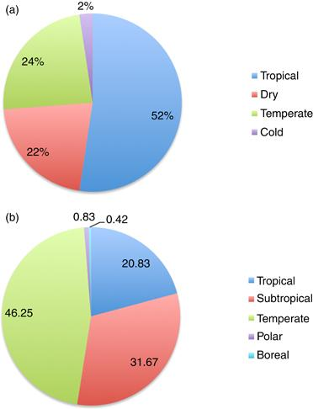
The incidence of polyploidy in animals
Relatively rare occurrence compared to plants.
Three hypothesis of lower incidence:
Disruption of meiosis and segregation of sexual chromosomes leading to aneuploidy.
Alteration of genetic balance between sex chromosomes and autosomes.
More restrictive genomic networks and developmental plasticity.
Anurans
(amphibians).
Fish.
© Mable B. K..

Slide 9
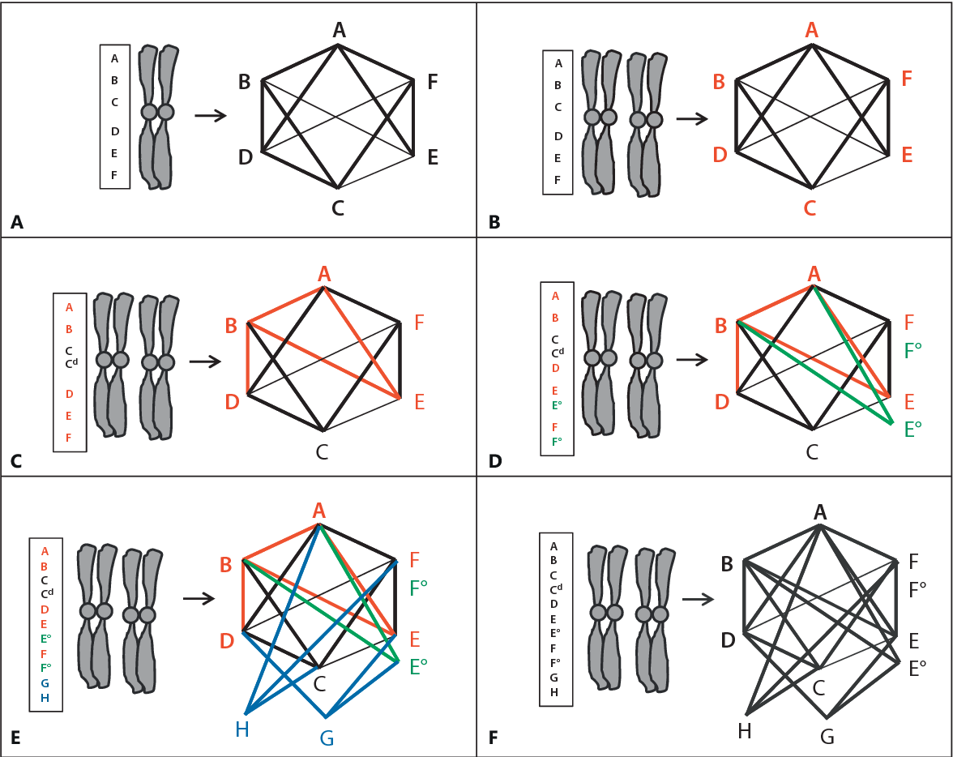
Genomic networks
Possible changes in genomic networks:
Different gene interactions (C)
Diversified and subdivided functions (D)
Recruitment of new genes (E)
Genomic networks are probably more restrictive in animals
© Wertheim B.

Slide 10
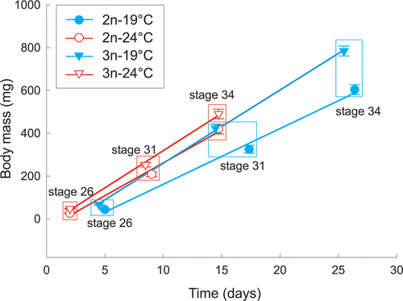
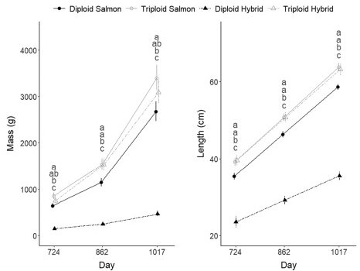
Amphibians Fish
© Hermaniuk A.
© Fraser T.

Slide 11
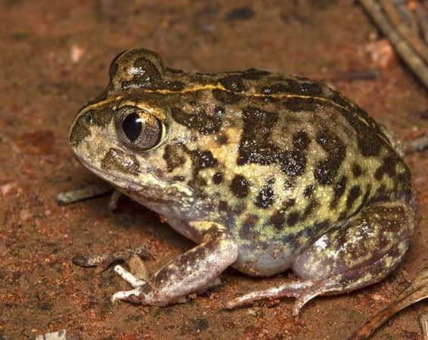
Genetic dynamics and geographical distribution of Neobatrachus frog species
Neobatrachus is a genus of frogs indigenous to Australia, distributed across the entire continent
Comprises 9 species, 6 diploids (2n=24) and 3 tetraploids (2n=48)
Speciation estimated to have occurred approx. 4 Mya
© Rowley J.

Slide 12
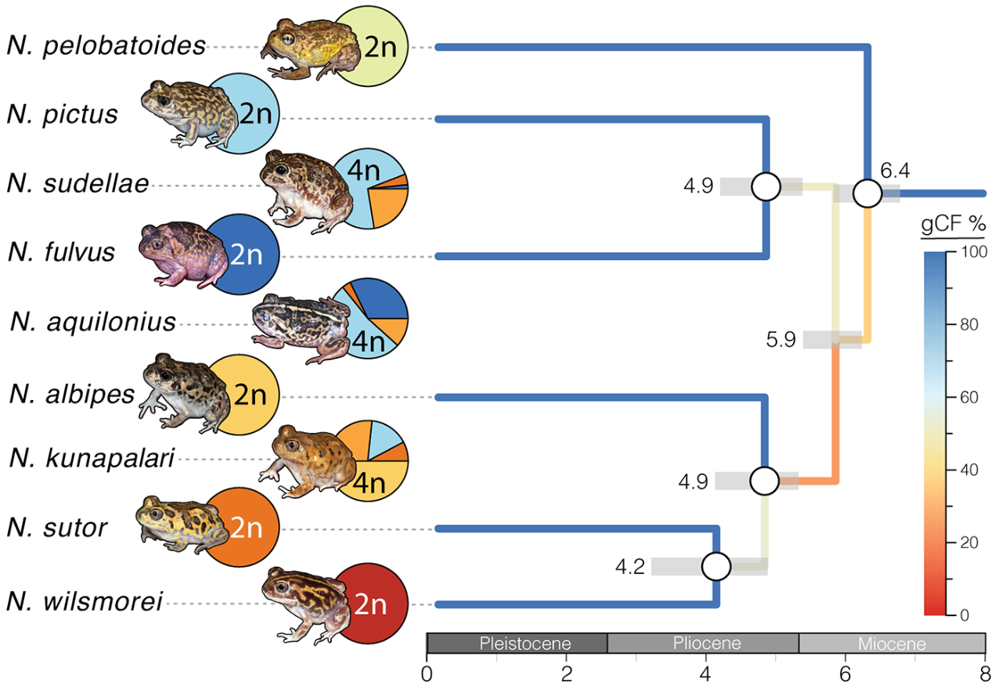
Material and methods
Analyzed 439 loci from 87 individuals
Climatic factors gathered from WorldClim project
Current geographical distribution collected from AmphibiaWeb.org
© Novikova P.Y.

Slide 13
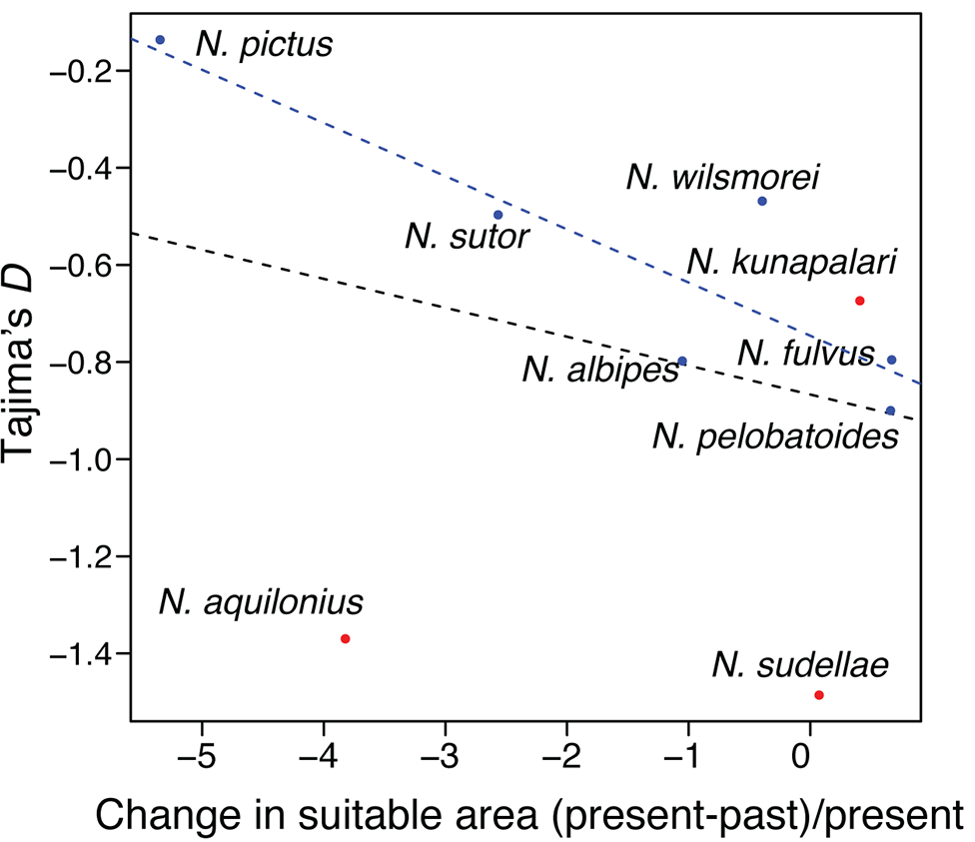
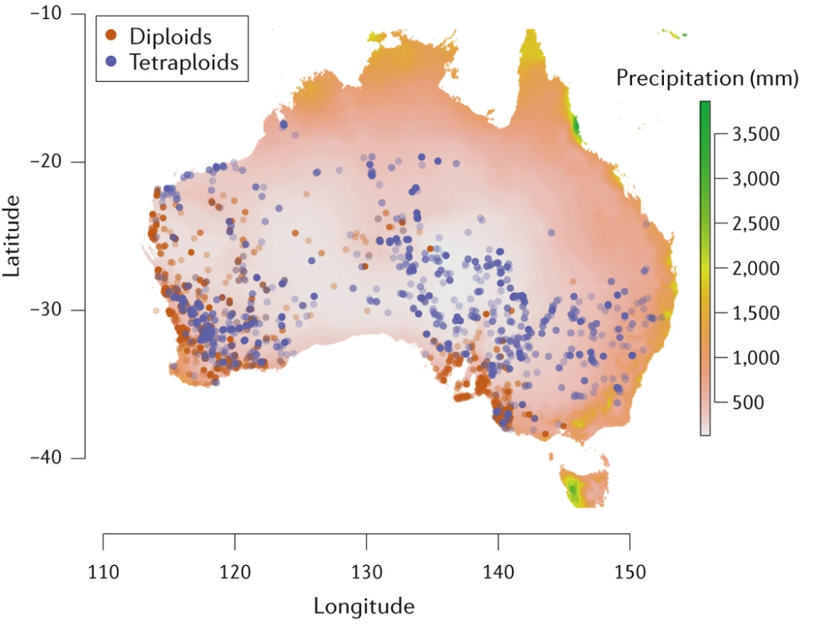
Results
© Novikova P.Y.
None of the species show a dramatic decline in population diversity
Diploid species are genetically isolated, meanwhile tetraploids can hybridize with each other and diploids
Tetraploids have a larger geographical distribution and are better adapted to drier regions
© Novikova P.Y.

Slide 14
Conclusion
Polyploidy is at the base of the evolution of angiosperms and vertebrates
Could be a method for plants to increase their fitness, especially in extreme environments
In animals has more controversial effects and responses are more species-specific
Used in fish cultivations to increase growth and isolate from wild populations, but usually more susceptible to stress factors
Amphibians could gain an increased adaptability to new environments

Slide 15
References
Novikova P.Y., Brennan I.G., Booker W., Mahony M., Doughty P., Lemmon A.R., Lemmon E.R., Roberts J.D., Yant L., Van de Peer Y., Keogh J.S., Donnellan S.C. (2020). Polyploidy breaks speciation barriers in Australian burrowing frogs Neobatrachus. PLoS Genetics, 16(5): e1008769. https://doi.org/10.1371/journal.pgen.1008769
Weiss-Schneeweiss H., Emadzade K., Jang T.-S., Schneeweiss, G.M. (2013). Evolutionary Consequences, Constraints and Potential of Polyploidy in Plants. Cytogenetic and Genome Research, 140 (2-4): 137–150. https://doi.org/10.1159/000351727
Wertheim B., Beukeboom L.W., van de Zande L. (2013). Polyploidy in Animals: Effects of Gene Expression on Sex Determination, Evolution and Ecology. Cytogenetic and Genome Research, 140 (2-4): 256–269. https://doi.org/10.1159/000351998
Fraser T.W.K., Hansen T.J., Remø S.C., Olsen R.E., Fjelldal P. G. (2022). Triploid Atlantic salmon × brown trout hybrids have similar seawater growth and welfare issues as triploid Atlantic salmon, but both were heavier at harvest than their diploid counterparts. Aquaculture, 552:737975. https://doi.org/10.1016/j.aquaculture.2022.737975
Hermaniuk A., Rybacki M., & Taylor J.R.E. (2016). Low Temperature and Polyploidy Result in Larger Cell and Body Size in an Ectothermic Vertebrate. Physiological and Biochemical Zoology, 89:2, 118-129. https://doi.org/10.1086/684974
Mable B.K., Alexandrou M.A. & Taylor M.I. (2011). Genome duplication in amphibians and fish: an extended synthesis. Journal of Zoology, 284: 151-182. https://doi.org/10.1111/j.1469-7998.2011.00829.x
Van de Peer Y., Mizrachi E. & Marchal K. (2017). The evolutionary significance of polyploidy. Nature Reviews Genetics, 18: 411–424. https://doi.org/10.1038/nrg.2017.26

